Slide 1
Intro to multivariate AR(1) models estimating interaction strengths, aka the B matrix
Eli Holmes
FISH 507 – Applied Time Series Analysis
23 February 2017

Slide 2
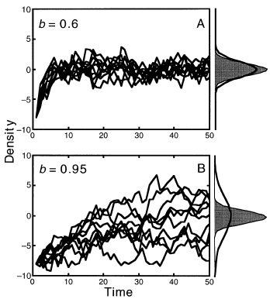
Mean-reverting processes
In lecture, I will talk about estimating mean-reversion in the context of density-dependence and species interactions, but mean-reverting stochastic processes are ubiquitous.
The Ornstein-Uhlenbeck process is the classic continuous time mean-reverting stochastic process. In the population dynamics literature, the Gompertz model is the classic discrete time mean-reverting process (although the Gompertz model also refers to a continuous time version).

Slide 3
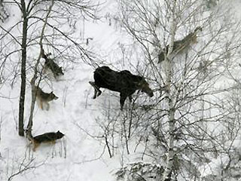
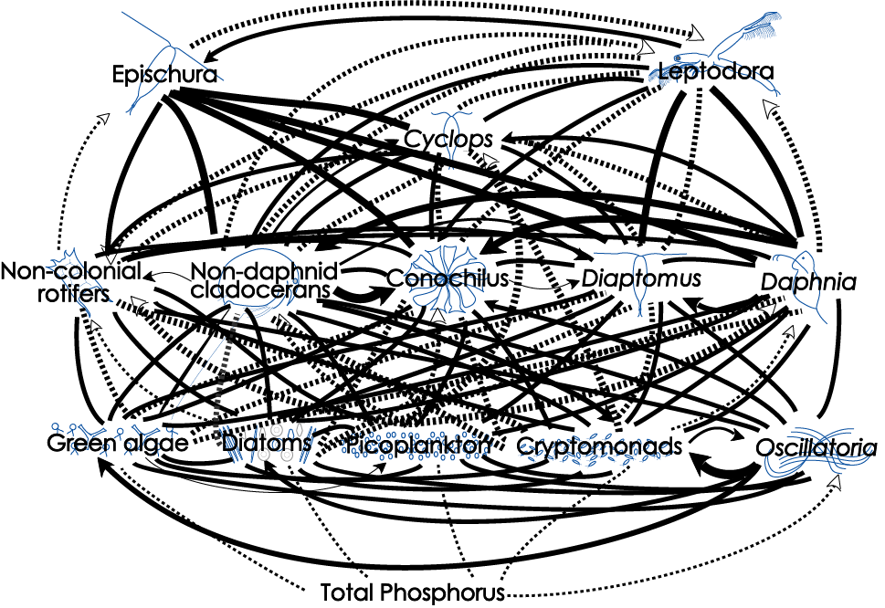
Univariate and multivariate Gompertz models
Univariate models
Estimating density dependence
or b term
Simple 2-spp model
2x2 B matrix
Large multivariate models
Big B matrices

Slide 4
Density dependence
univariate discrete exponential growth not in log-space
univariate discrete density-dependent growth not in log-space
general
Specific type
The shape of f(n_t-1) determines the dynamics of the system:
stable or unstable equilibrium
Speed at which equilibrium is approached
Equilibrium level
Sensitivity to perturbations

Slide 5
The Gompertz model
univariate discrete time deterministic Gompertz model
not in log-space
|b| < 1 “negative” density-dependence
b = 1, no density-dependence
|b| > 1, “positive” density-dependence (blows up)
The closer b is to 0, the stronger the density-dependence (stronger the pull back to the mean). If b=1, there is no “pull” back to the “mean” (the mean is not in fact defined for this case).

Slide 6
Gompertz model written in log space AR(1)
Taking the natural log of both sides
Substituting x_{t} for ln n_{t}
AR(1) minus the noise term

Slide 7
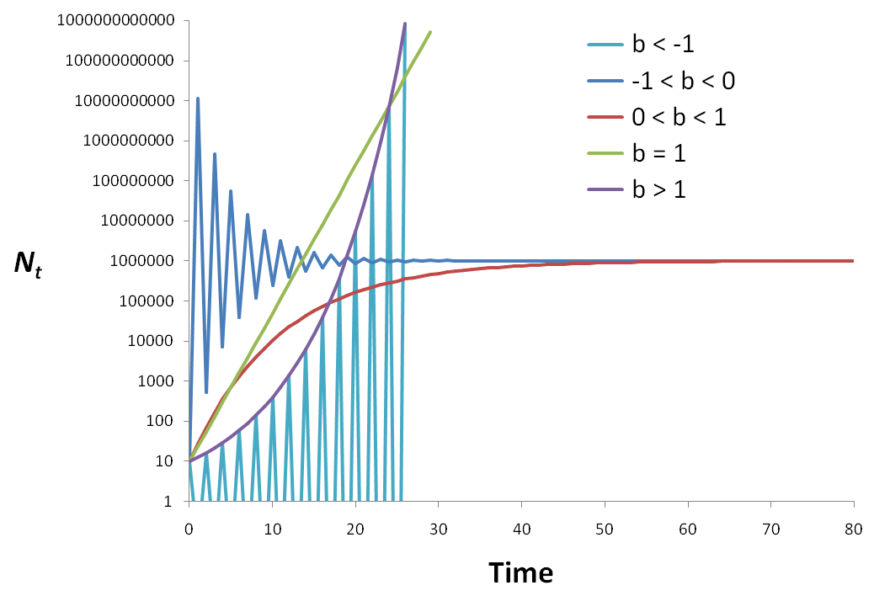
Examples of the Gompertz for different b
Our interest
u/(1-b)

Slide 8
Equilibrium for the deterministic Gompertz model
the model reaches equilibrium at t = ∞, so we can write
And via some algebra, we arrive at:
(provided b ≠ 1)
The equilibrium is a function of BOTH u and b.
This is rather unfortunate.

Slide 9
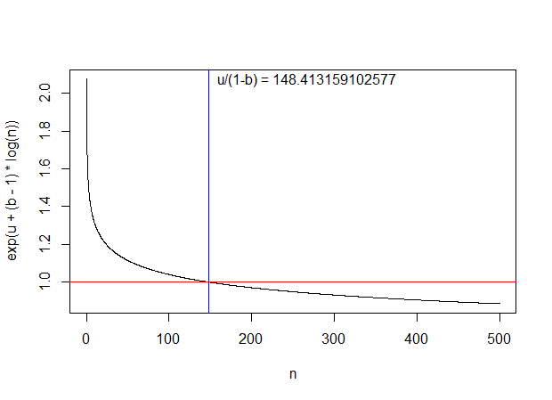
Equilibrium for the deterministic Gompertz model
u=.5; b=.9; n=seq(0.1,500,.1)
plot(n,exp(u+(b-1)*log(n)),type="l")
abline(h=1,col="red"); abline(v=exp(u/(1-b)),col="blue")
text(exp(u/(1-b)), exp(u+(b-1)*log(n[1])), paste("u/(1-b) =",exp(u/(1-b))),pos=4)

Slide 10
Add stochasticity (process error)
Adding stochasticity yields a univariate, lag-1 autoregressive or “AR(1)” process:
If |b| < 1, the process is “stationary”
If b = 1, the process is a “random walk” & “non-stationary”
Known as the discrete-time Ornstein-Uhlenbeck process in physics but as Gompertz or stochastic Gompertz model in population dynamics.

Slide 11
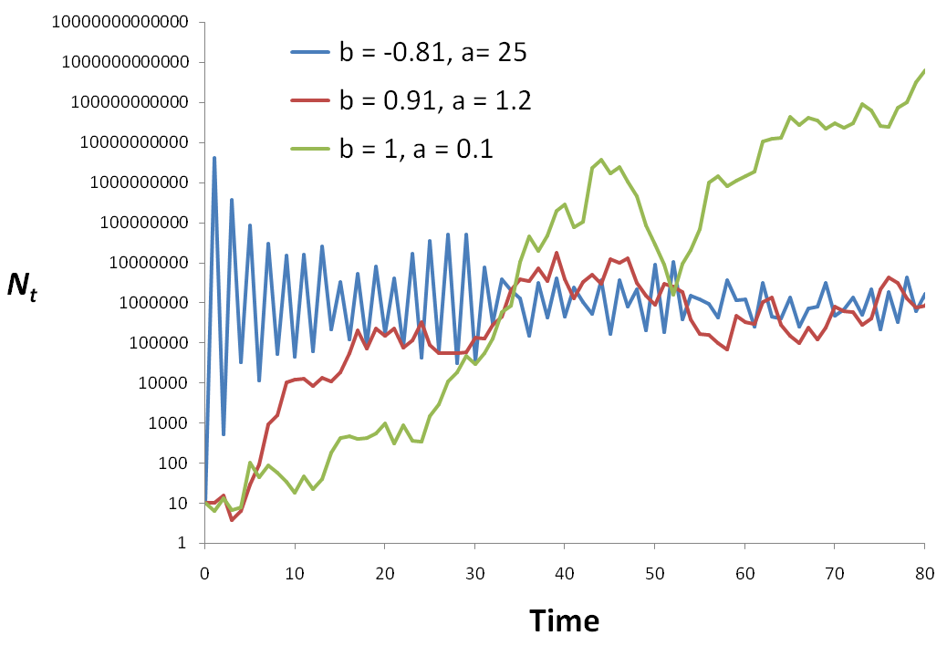
Example realizations
random walk
b=1
2-pt oscillation
u/(1-b)

Slide 12
Equilibrium for the stochastic Gompertz process
It has a stationary distribution
probability distribution of X_{t} as t → ∞
given |b| < 1
Normally distributed with
mean μ∞ and variance υ∞
Fig. 1 - Ives et al. (2003)

Slide 13
Properties of the stationary distribution
Assuming |b| < 1 (i.e. a stationary process)
mean
(provided b ≠ 1)
variance

Slide 14
Main properties
Basic features of the Gompertz process
Mean reverting, aka density-dependent
Stationary, so it fluctuates around a mean
Point equilibrium as opposed to a cycle equilibrium like Lotka-Volterra (Lynx & hare) models you studied (maybe) in Ecology 101
Can be seen as a locally linear approximation of other types of density-dependent interaction models
“locally linear” is jargon for “only holds for sure if x doesn’t change too much”. In our case, x = log(n) = log abundance.
S. E. Hampton, NCEAS, UCSB, hampton@nceas.ucsb.edu, 7 July 2007

Slide 15
Parameter estimation in R
Open up R and follow after me
Gompertz_example_0.R

Slide 16
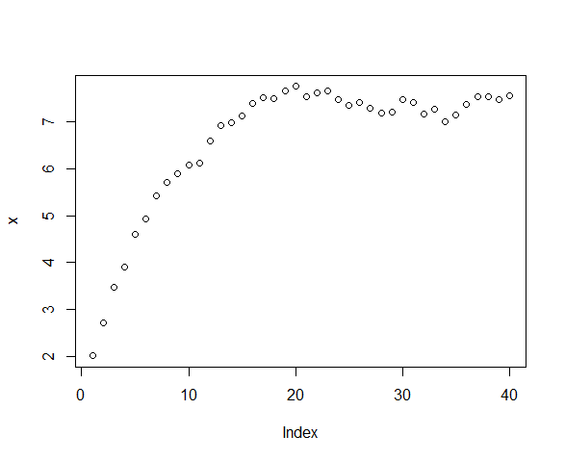
We need to be careful if the data are NON-stationary
MANY (most) fitting algorithms assume the data are drawn from the stationary distribution and thus are only applicable if your data are stationary distribution. MARSS does not assume the stationary distribution, fyi.
non-stationary
stationary

Slide 17
observation error is known a problem obs error = spurious density-dependence
2010
2008

Slide 18
Parameter estimation accounting for obs error
Gompertz_example_1.R estimation technically easy..
Gompertz_example_2.R replication
Gompertz_example_3.R ML on the edge

Slide 19
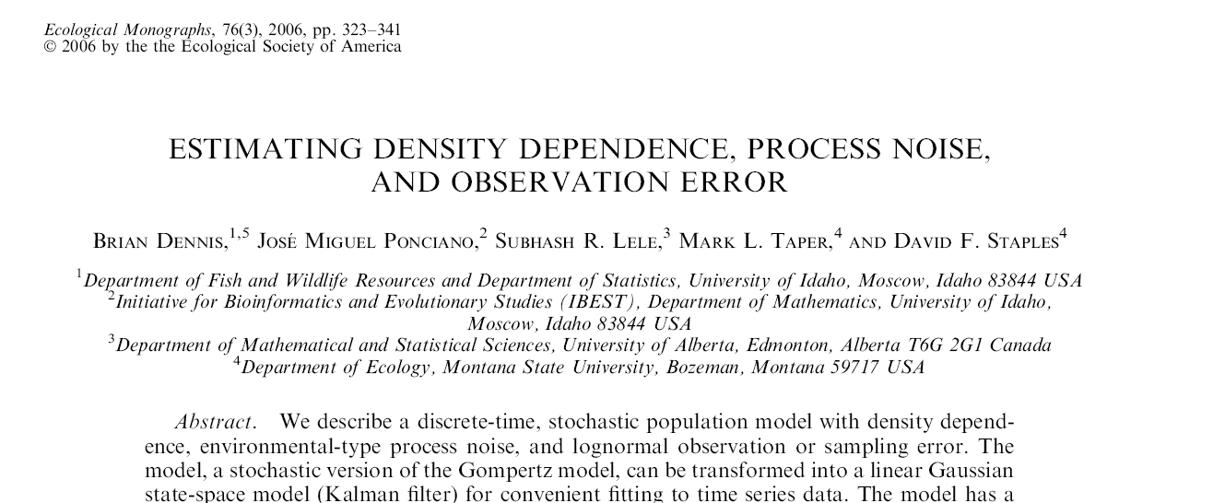
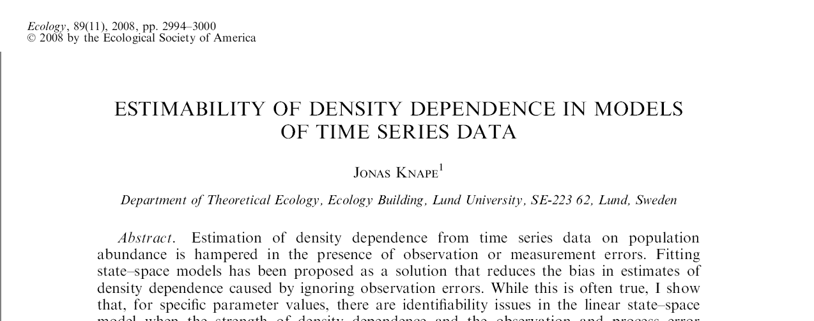
Estimating R matrix is not so easy, but replication helps A LOT
MARSS models (however you fit them) allow you to easily incorporate replication.

Slide 20
Estimation much easier if you can assume that your data are a sample from the stochastic equilibrium
Process has reached
equilibrium

Slide 21
How to estimate b when you are willing to assume the data come from stoc. equil.?
Idea #1 Impose the constraint that
W(t)=(y(t)-y(t-1)) and
W(t)-W(t-1)
Have the variance-covariance structure of a stochastic Gompertz observed with error.
Compute Q from the total sample variance and the estimate of b

Slide 22
How to estimate b when you are willing to assume the data come from stoc. equil.?
Idea #2 If you subtract E(x(t)) then U=0
Use mean(data) as E(x(t))
Has the added value of removing “a” too!
Used in Ives et al 2003
Gompertz_example_4.R

Slide 23
Important messages
u and B are confounded. Likelihood is banana-shaped, so we need to constrain u
de-mean the data; set u=0; set tinitx=1
don’t demean data; set u=0; estimate a; set tinits=1
don’t demean data; use covariates in obs to model level
be careful in what covariates you include in the process model (you’re introducing u via Cc)
What happens when we add observation error?
Estimation is more difficult.
Replication will help us estimate R vs Q

Slide 24
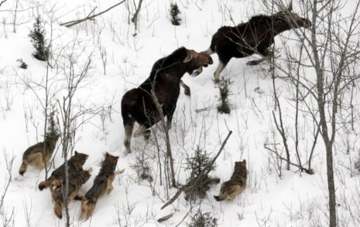
2-species: Predator-Prey
Moose
Wolf

Slide 25
MAR(1): x_{t}=Bx_{t-1} + u + w_{t}
“spp” abundance
B = interaction matrix
Process variation
MVN(0,Q)
Notes:
25
Notice diagonal is different. If diagonal is <1 then b(i,i) is negative and spp i has a negative effect on itself. NOW the variation is added

Slide 26
Meaning of the B matrix
Inter-specific effects
(can be set to zero)
Inter-specific effects
(can be set to zero)
Intra-specific effects
effect of spp i on itself,
aka density-dependence

Slide 27
Observation error causes
Spurious density-dependence, i.e. apparent stronger effect of self on self
Spuriously low species interaction strengths, i.e. apparent lower effect of other on self
Inter-specific effects
(go to 0)
Intra-specific effects
go to 0

Slide 28
Adding covariates
covariates
B = interaction matrix
covariate effect
Process variation not from covariates (“unexplained”)
Notes:
28
Notice diagonal is different. If diagonal is <1 then b(i,i) is negative and spp i has a negative effect on itself. NOW the variation is added

Slide 29
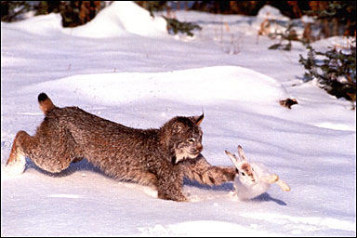
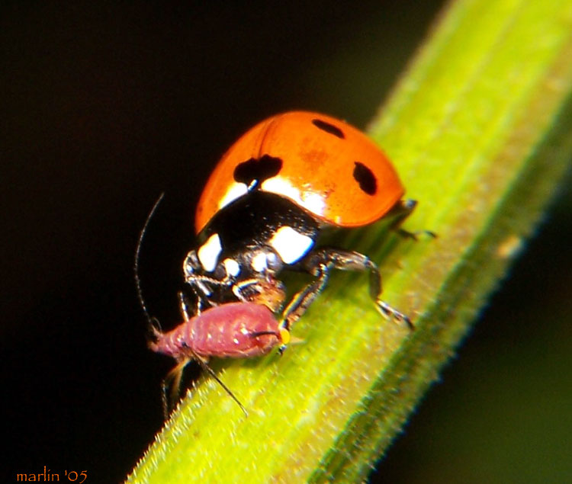
Lotka-Volterra predator-prey interactions
S. E. Hampton, NCEAS, UCSB, hampton@nceas.ucsb.edu, 7 July 2007

Slide 30
Simple 2-species system Predator & Prey
Data are simulated using a discrete time version of a Lotka-Volterra model with density-dependence in the herbivore– easy to change interaction strength
H = herbivore sp
P = predator sp.
b = herbivore birth rate
K = herbivore carrying-capacity
a = per capita attack rate
e = conversion efficiency (consumed prey turning into new predators)
s = death rate for predators
dH/dt=
bH(1 - H/K) - a H P + w_{h}
dP/dt =
e(aPH) - sP + w_{p}
S. E. Hampton, NCEAS, UCSB, hampton@nceas.ucsb.edu, 7 July 2007

Slide 31
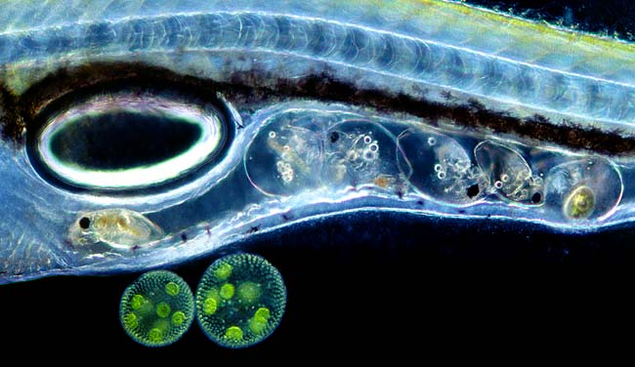
This model can display a variety of dynamics
S. E. Hampton, NCEAS, UCSB, hampton@nceas.ucsb.edu, 7 July 2007

Slide 32
Estimate strength of density-dependence and interaction strength using MARSS
LV_example_1.R
change conversion efficiency of predator
LV_example_2.R
add observation error
LV_example_3.R
covariate affects K of herbivore
LV_example_4.R
covariate affects conversion efficiency of predator

Slide 33
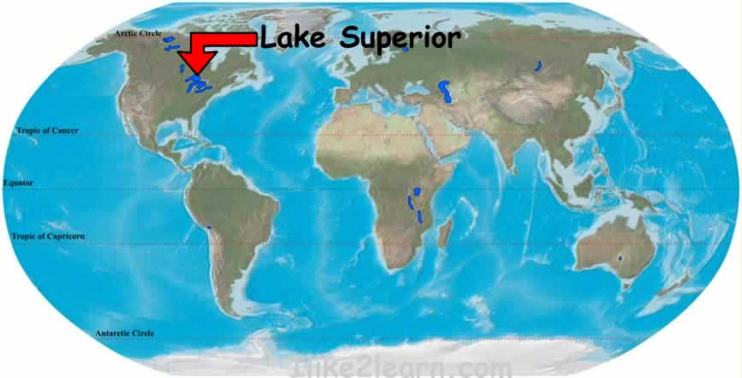
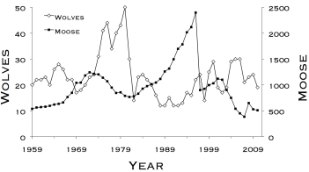
Computer lab: the moose and wolf dynamics on Isle Royale
data and images from www.isleroyalewolf.org

